Slide 1
Advanced Phishing Threats (APT) – Exploiting Modern Features
Payton Miller

Slide 2


Cyber Security Engineer at Open Security
Certifications: GSEC, GCIH, GPEN, GEVA, GFACT
I absolutely love finding obscure ways to break applications, on modern web applications, or the legacy protocols that support them.
@aLilSus

Slide 3
What is Phishing?

Slide 4
Terms
Social Manipulation – Convincing a victim to perform an action that results in any information disclosure.
Social Manipulation:
Phishing – Email Delivery
Vishing – Voice Delivery
Smishing – SMS Delivery

Slide 5
Identifiers of Phishing
Bait – Issue or service that the individual or individual’s business needs to resolve.
Register for new company benefits.
Download an update to secure your system
You qualify for an Economic Impact Payment (EIP)
Deadlines – Call to Action that pressures individuals to interact with the email.
Failure to submit this data by Tuesday, will result in account termination.

Slide 6
Statistics
Domain Registration to Phishing – 14 days.
https://interisle.net/PhishingLandscape2021.pdf
Microsoft is 43% of Phishing Campaigns
Collected Data
Credentials
Personal Data
Medical Information
https://www.tessian.com/blog/phishing-statistics-2020/

Slide 7
Why does it work?

Slide 8
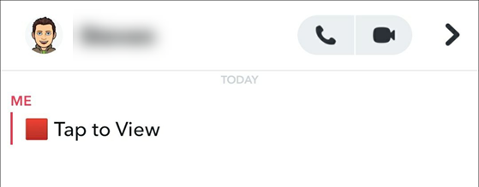
It works

Slide 9
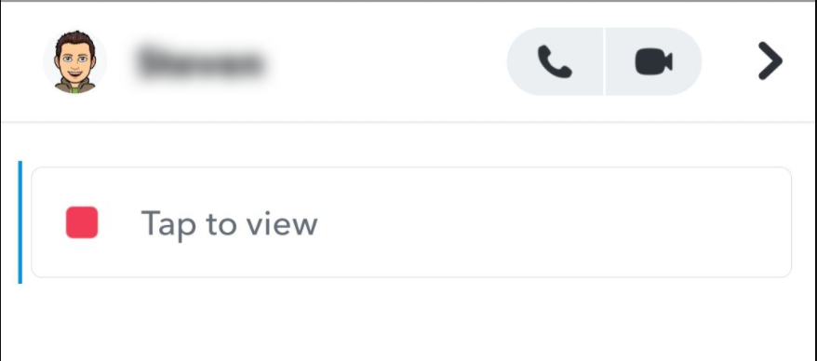
It works

Slide 10
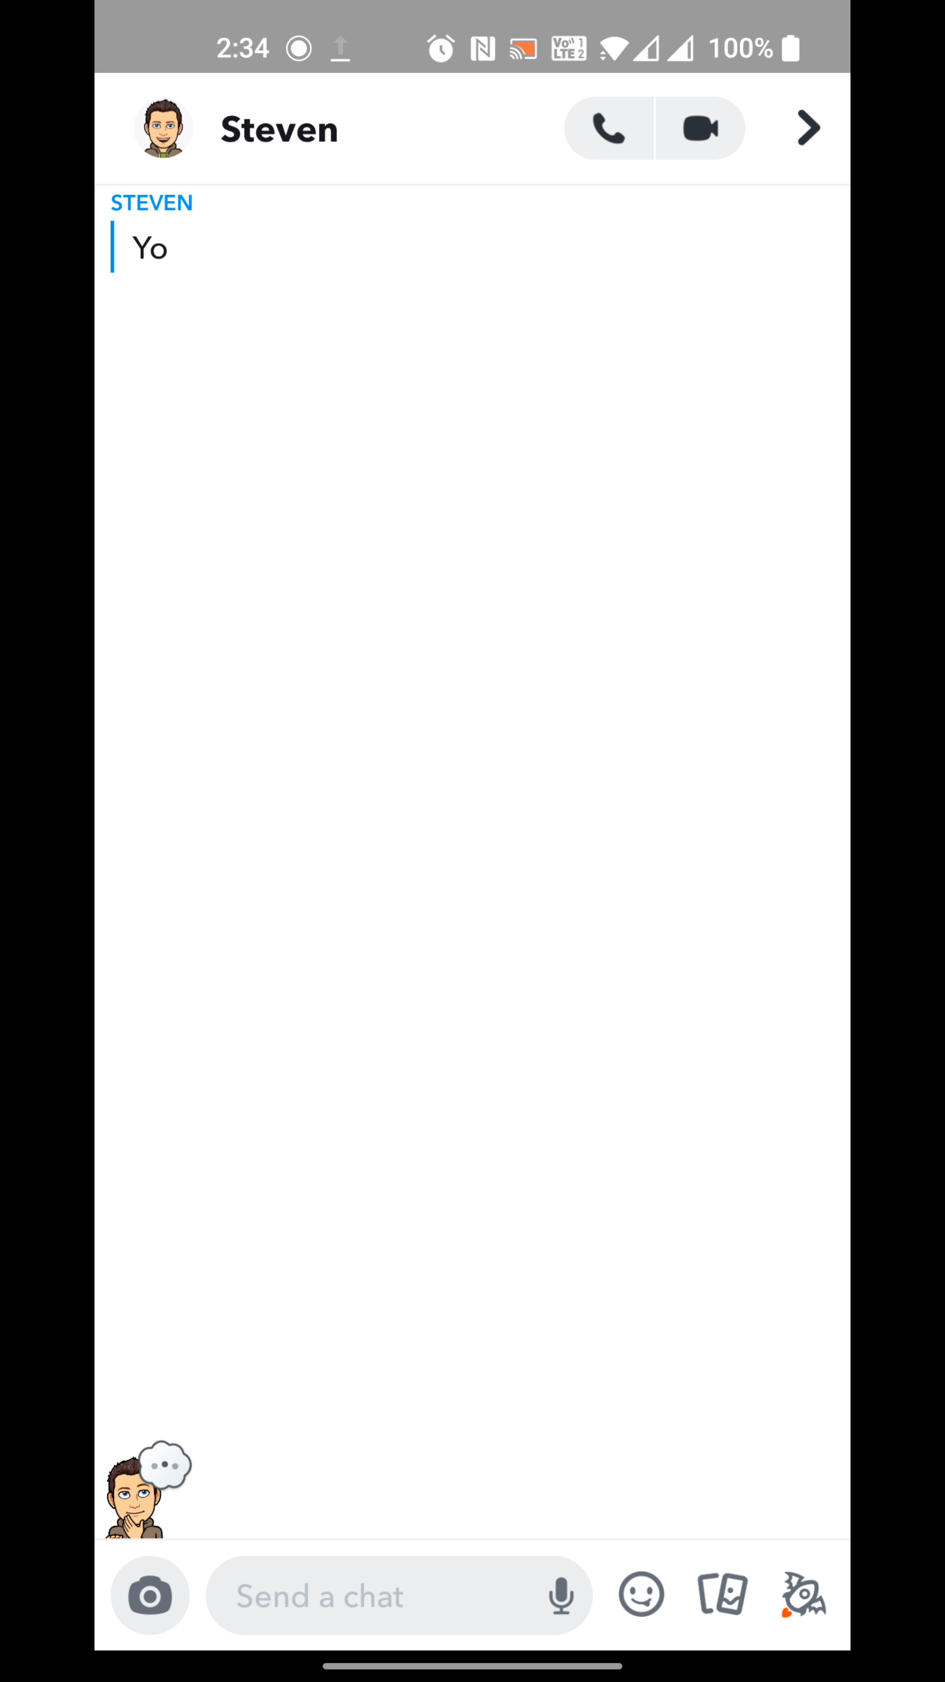
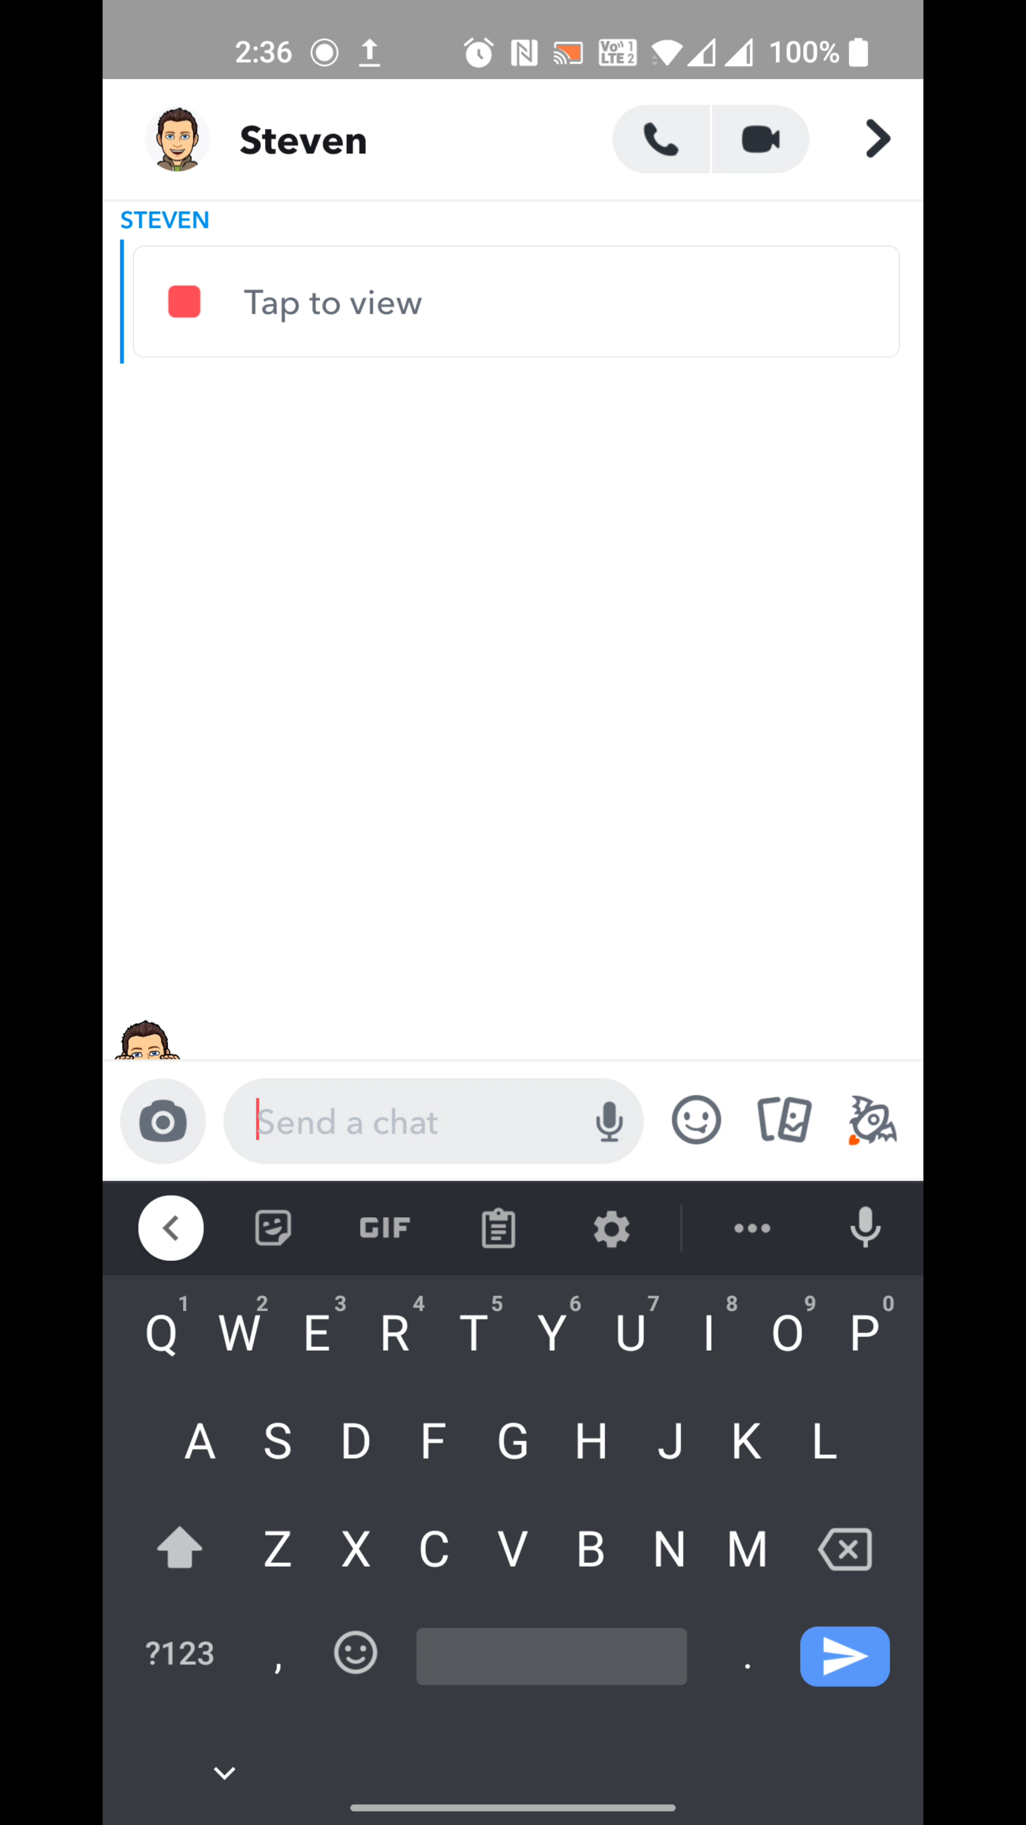
It works
Notes:
Demo of why Snapchat manipulation works.

Slide 11
Social Manipulation
100% Click Rate.
No vulnerability is embedded with this message.
If a vulnerability was found that required user interaction, we have a 100% Click Rate.
Snapchat conditions users to click on these dialogs to load images – ALL THE TIME – You get points for it!

Slide 12
Where are we?

Slide 13

Domain Sprawl
Domain name per service.
Trusted domains / partners are not listed publicly.
Organizations recommend third-party services.
Indexing websites are information disclosures
/sitemap.xml and /robots.txt – provide search engines with too much information of files that should not be discoverable, similar implications of providing external service lists.

Slide 14
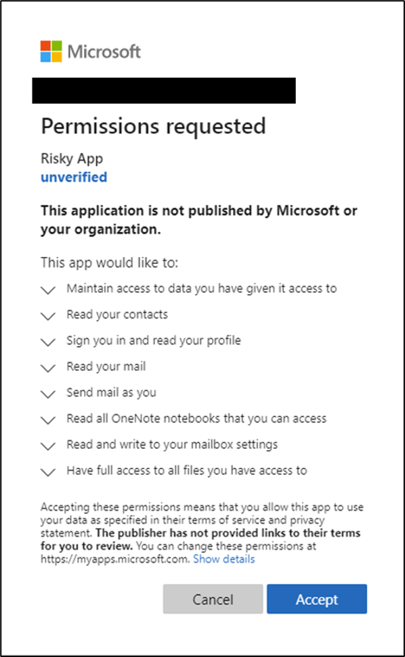
Consent Based Phishing
Clicking “Accept” allows this application to perform all actions
Permissions should be delegated on a principle of least privileged.
What could result from accepting this malicious application?
https://t.co/AvYxbfrjRN
Agnieszka Girling, A. G. (2020, July 8). Protecting your remote workforce from application-based attacks like consent phishing. Microsoft. https://www.microsoft.com/security/blog/2020/07/08/protecting-remote-workforce-application-attacks-consent-phishing/

Slide 15
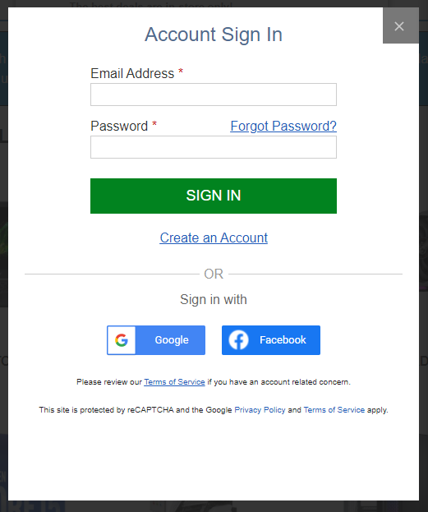
Third Party APIs
APIs – websites requesting data from other publicly trusted websites.
Authentication (Facebook, Google, Microsoft)
Payment Portals (Stripe, Square, Paypal)

Slide 16
Legacy Techniques – that still work (circa 2002)

Slide 17
Typo Domain Squatting
Purchasing a domain like Google.com
Remove characters
Duplicate characters
Choose different TLDs
Follow the organization’s naming convention of other popular services by that web entity.

Slide 18
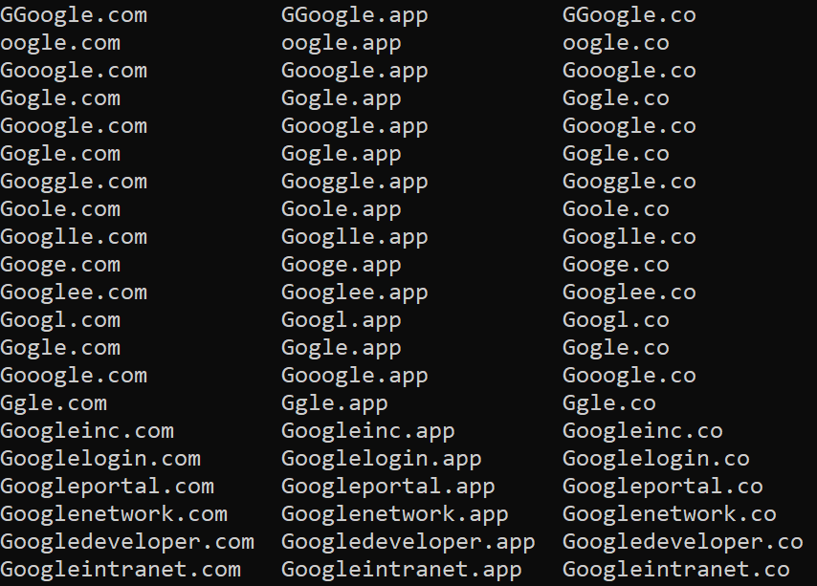
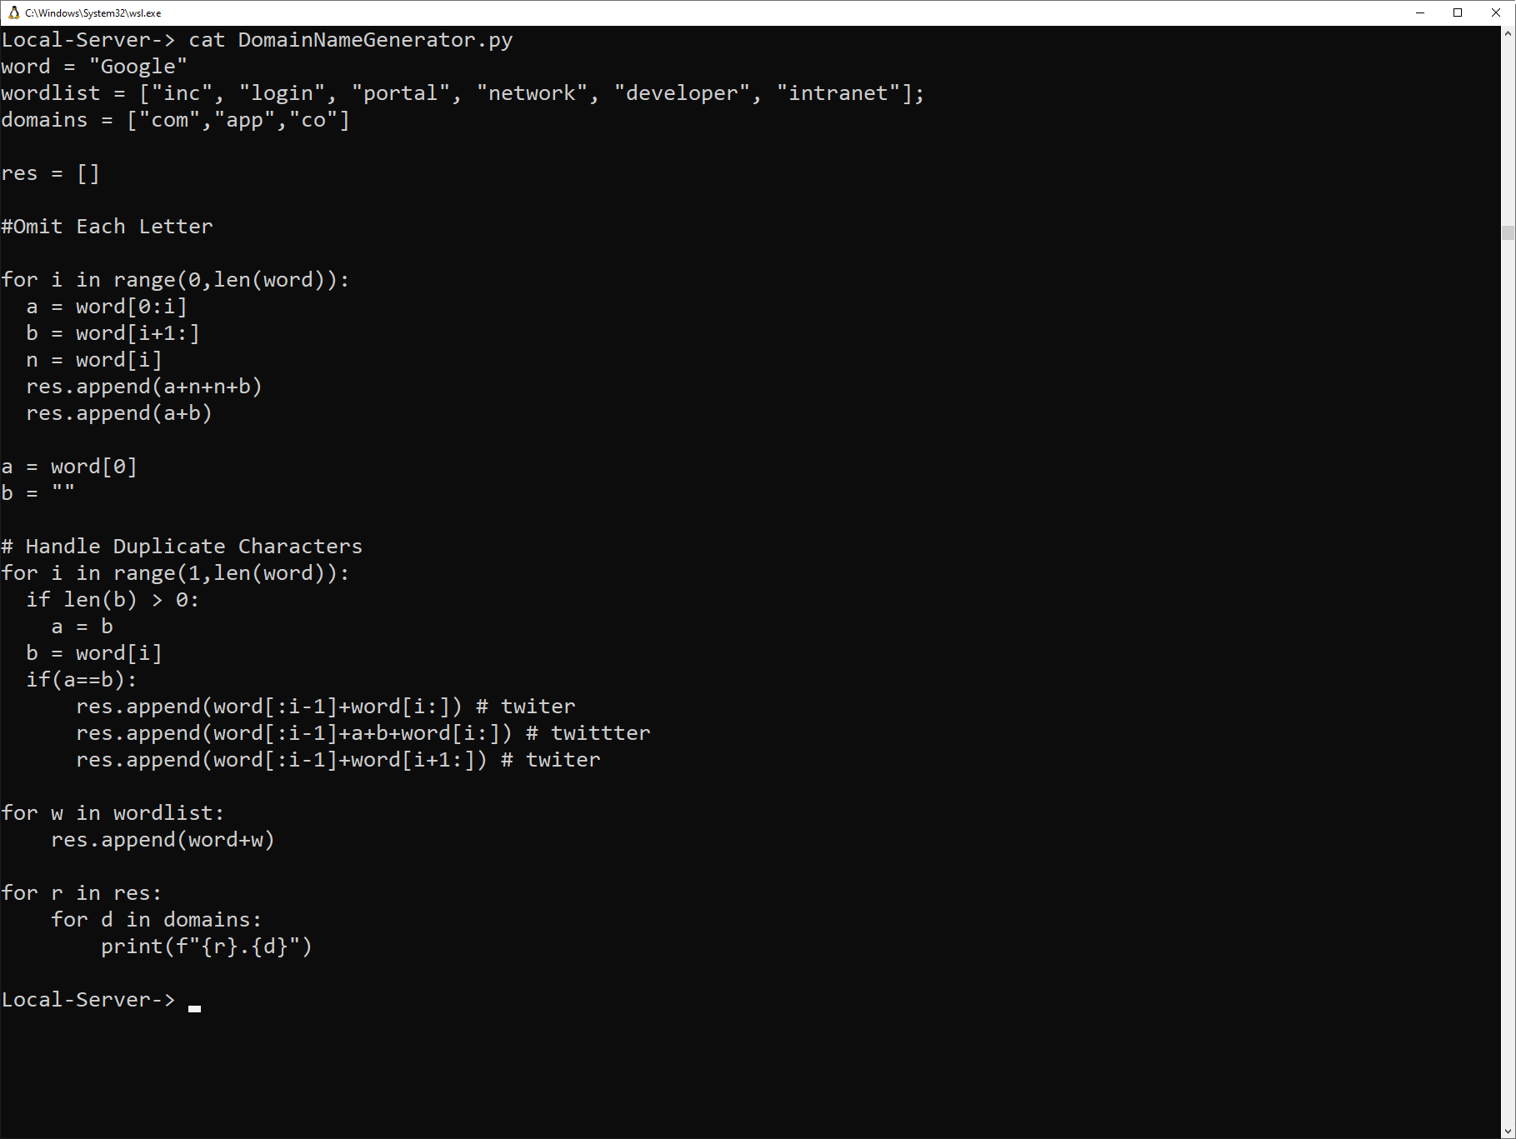
Python Subdomain Enumeration in BSsides-Resources

Slide 19
Internationalized Domain Names (IDNs)
Majority of browsers display Punycode variant.
Limited to one character set
Symbolic Domain Name | Punycode Equivalent
ᴍicrosoft.com | http://xn--icrosoft-qy7c.com/
тшіттег.com | http://xn--c1ad2baa8a0g.com/
Notes:
Punycode is a form of encoding, prefix with xn– which is a safe way to render Unicode characters.

Slide 20
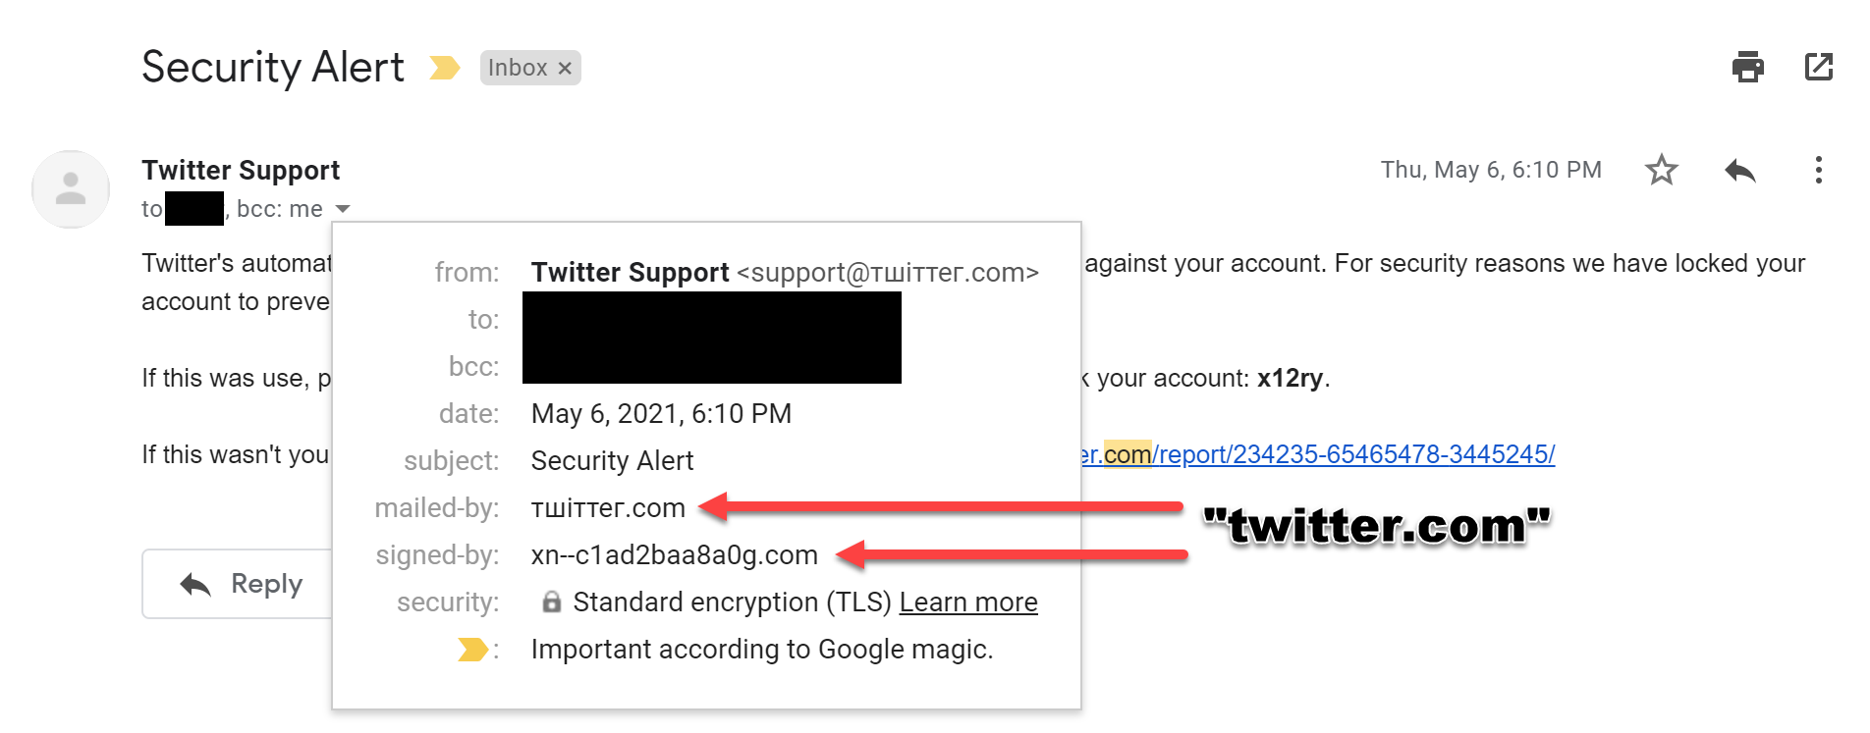
Notes:
Sending email with an IDNs

Slide 21
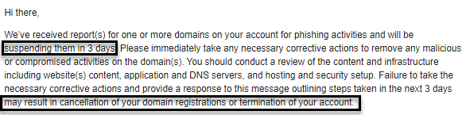
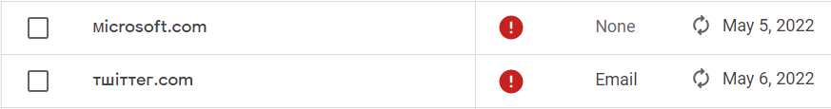
List of Suspended Domains
Google’s Courteous Correspondence
Notes:
Why we don’t send these techniques, a warning to those that are attempting to design Phishing Campaigns.

Slide 22
Achieving legitimacy through complexity.

Slide 23
Inheriting Trust
Site Exploitation – if users trust the organization, then we become the organization.
Open Redirections – Redirect to a website that we control to harvest information.
Cross Site Scripting (XSS)
http://test.com/redirect?url=http://attacker.co/

Slide 24
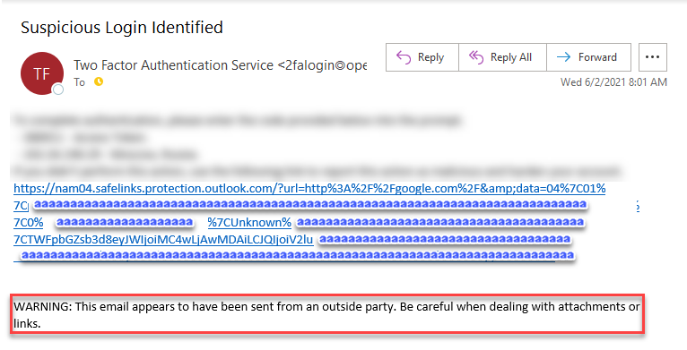
Link Filtering
Email services replaces external links to a managed open redirection.
If the redirection is flagged as malicious the organization can “stop” the redirection.

Slide 25
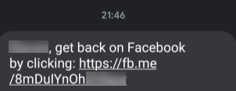
Abusable Services that host content
Link Shorteners
t.co, fb.me, bit.ly
File Hosting
Google Storage
S3 Buckets
Free Subdomains
https://[domain].web.app
https://[domain].firebase.com
https://[domain].appspot.com
https://[domain].azuresites.net

Slide 26
Abusable Services that host content
Website Creators
Wordpress
Wix
SquareSpace
Joomla
Forms
Google Forms
Microsoft Forms
Jotform
Formstack

Slide 27
Trusted Services that perform actions
Trusted Platform as a Service
External adversary sends meeting invite to employee of an organization.
Internal employee sees the meeting, and rushes to get in the call.
Meeting invite contains a link to a third-party videoconferencing application, which contains a backdoor.
Employee in a rush to join the meeting, does not trust the software, but supervisors expect that employee to be in the meeting.

Slide 28
Illegitimate Businesses Case studies
Step 1) Create Business
Step 2) …?
Step 3) Profit!
Notes:
Pseudo Cybersecurity Company - https://securityaffairs.co/wordpress/123673/cyber-crime/fin7-fake-cybersecurity-firm.html
“FIN7 hacking group created fake cybersecurity companies to hire experts and involve them in ransomware attacks tricking them of conducting a pentest.”
Pseudo Salary Analytical Firm – Argile / Fintech https://krebsonsecurity.com/2021/05/fintech-startup-offers-500-for-payroll-passwords/
“How much is your payroll data worth? Probably a lot more than you think. One financial startup that’s targeting the gig worker market is offering up to $500 to anyone willing to hand over the payroll account username and password given to them by their employer, plus a regular payment for each month afterwards in which those credentials still work."

Slide 29
Trust Relationships Open Authentication (OAUTH)

Slide 30
OAUTH except it’s not OAUTH
Do we trust the registration process of a malicious website? NEVER
Do we trust the website to authorize via Google? ALWAYS

Slide 31
Abusing “OAUTH”
Scam.html
This file is not publicly shared and will not be in the near-future.
The Snapchat “red button” of the internet.

Slide 32
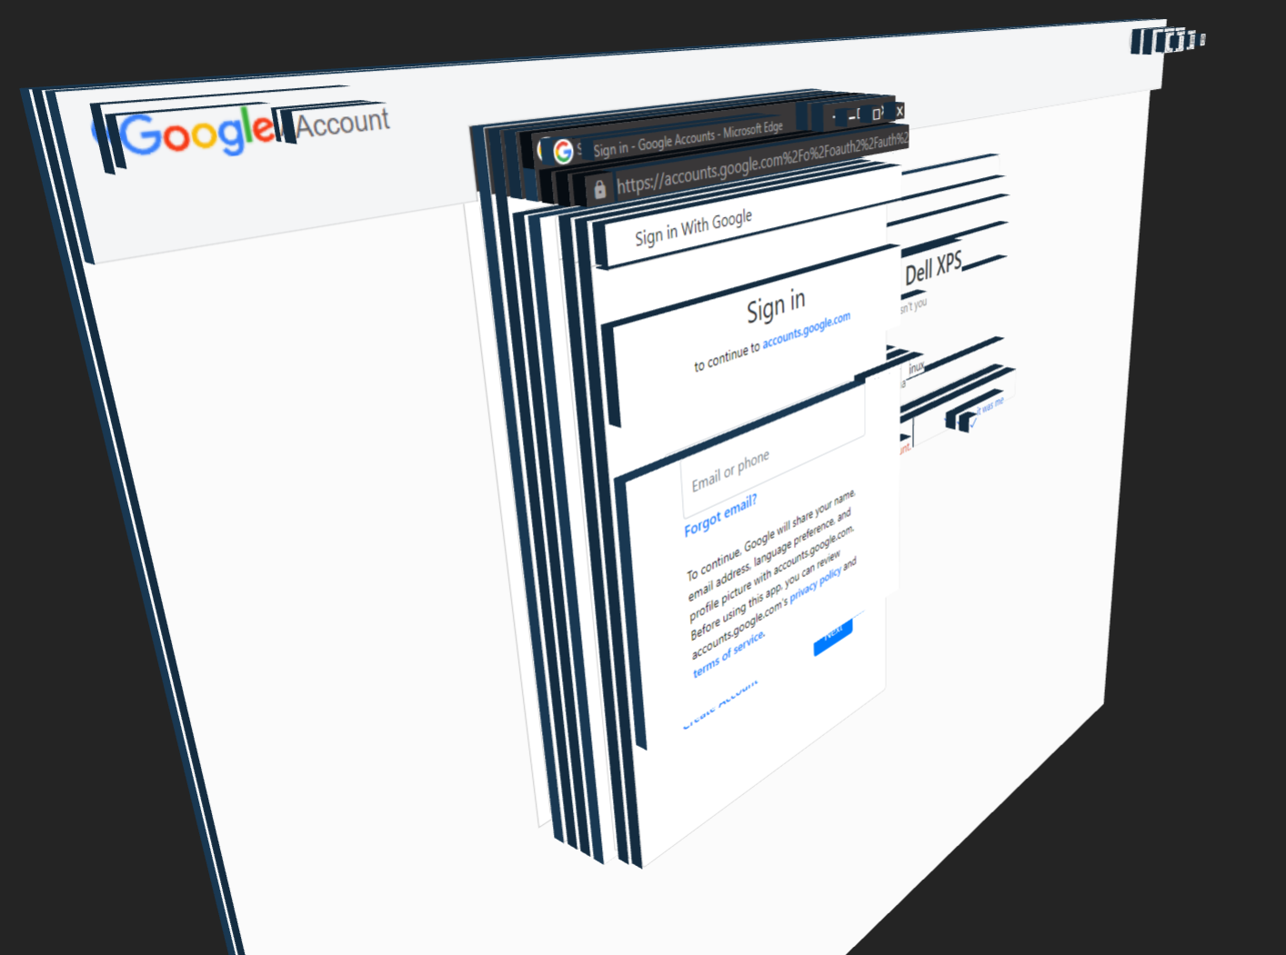
Transparency Window Attacks
OAUTH can prompt a new browser window
Adversaries can simulate this with Web Design
3D HTML Element Visualizer

Slide 33
Subdomain Impersonation

Slide 34
Requirements of a Subdomain
Accepted Standard.
Allowed Characters: [A-z 0-9 -_ . ]
Subdomain Delineator: [.]
Wildcard: [*]
Subdomain Divisions
Less than 127 subdivisions
Each division shorter than 63 characters
Total subdomain length shorter than 253-255 characters.

Slide 35
Valid Subdomains
app.app.app.app.app.app.app.app.app.app.app.
app.app.app.app.app.app.app.app.app.app.app.
app.app.app.app.app.app.app.app.app.app.app.
app.app.app.app.app.app.app.app.app.app.app.
app.app.app.app.app.app.app.app.app.app.app.
app.app.app.app.app.app.domain.com

Slide 36
Valid Subdomains
aaaaaaaaaaaaaaaaaaaaaaaaaaaaaaaaaaaaaaa
aaaaaaaaaaaaaaaaaaaaa.aaaaaaaaaaaaaaaaaa
aaaaaaaaaaaaaaaaaaaaaaaaaaaaaaaaaaaaaaa
aaa.aaaaaaaaaaaaaaaaaaaaaaaaaaaaaaaaaaaa
aaaaaaaaaaaaaaaaaaaaaaaa.aaaaaaaaaaaaaaa
aaaaaaaaaaaaaaaaaaaaaaaaaaaaaaaaaaaaaaa
aaaaaa.domain.com

Slide 37
Valid Subdomains
http.steam.com.forum-23489324832432.
homepage.domain.com

Slide 38
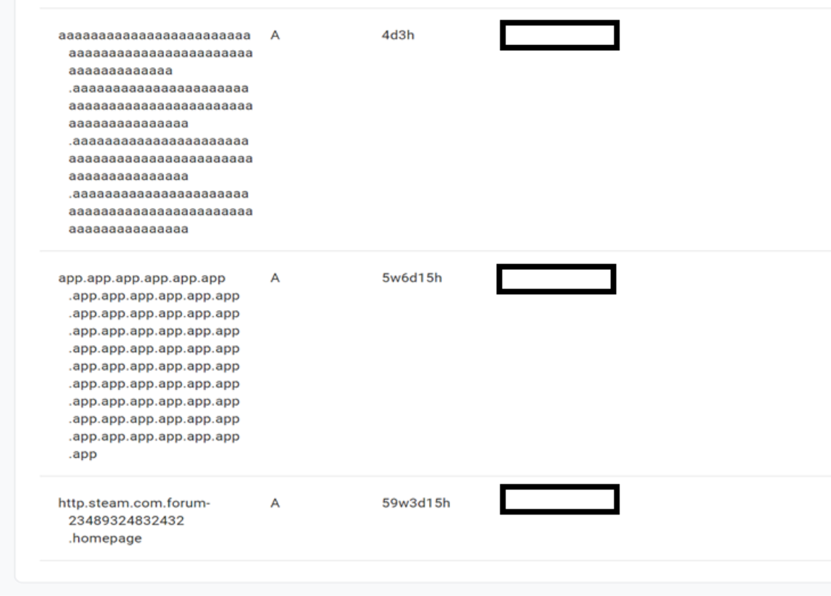
test.com
test.com
test.com

Slide 39
Impersonation via Subdomains
1) Find a trusted website with a long URL.
2) Open Subdomain Impersonator
3) Update DNS.

Slide 40
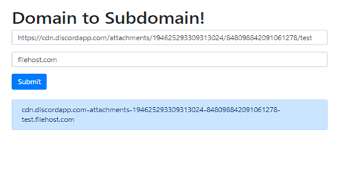
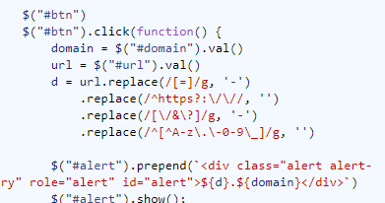
Impersonation via Subdomains
Replace = with -
Deleting http(s)://
Replace ?&/ with –
Delete bad characters
Append your domain name

Slide 41
Impersonation via Subdomains
https://cdn.discordapp.com- attachments-2343456456457345435-23434254364364564.test.download

Slide 42
Impersonation via Subdomains
cdn.discordapp.com- attachments-2343456456457345435-23434254364364564.test.download
Domain Name

Slide 43
Left-To-Right Override and Right-To-Left Override

Slide 44
LTR and RTL Encoding
Some languages including Arabic, Hebrew, Syriac, and Thaana (Divehi) are right to left.
Windows supports “bi-directional text encoding”… permits both directions in the same text-field
Is it a feature or vulnerability? What is the risk in bidirectional text encoding?

Slide 45
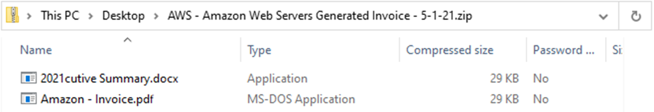
Displayed Filename | Unicode Filename | File Type
2021.Executive Summary.docx | 2021◄xcod.yrammuS evituc►.Exe | .exe
Advertising for Bsides.lnk.docx | Advertising for Bsides◄xcod.►.lnk | .lnk
.Jschaeffer Account – Invoice.pdf | ◄fdp.eciovnI – tnuoccA reffeahc►.Js | .js
Amazon.com – Invoice.pdf | Amazon◄fdp.eciovnI – ►.com | .com (.exe)
“File Name Extensions” - Disabled
RTLO (◄) is a symbol that overrides the text encoding from LTR to RTL with an Override | LTRO (►) is a symbol that overrides the text encoding from RTL to LTR with an Override

Slide 46
LTRO and RTLOs
Displayed Filename | Assumed extension | Real Extension
2021.Executive Summary.docx | .docx | .exe
Advertising for Bsides.lnk.docx | .docx | .lnk
.Jschaeffer Account – Invoice.pdf | .pdf | .js
Amazon.com – Invoice.pdf | .pdf | .com (.exe)
RTLO (◄) is a symbol that overrides the text encoding from LTR to RTL with an Override
LTRO (►) is a symbol that overrides the text encoding from RTL to LTR with an Override
What happens when the content in the rendered field does not match the real content of a field?

Slide 47
“File Name Extensions” - Disabled

Slide 48
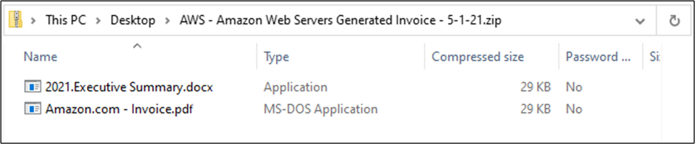
“File Name Extensions” - Enabled

Slide 49
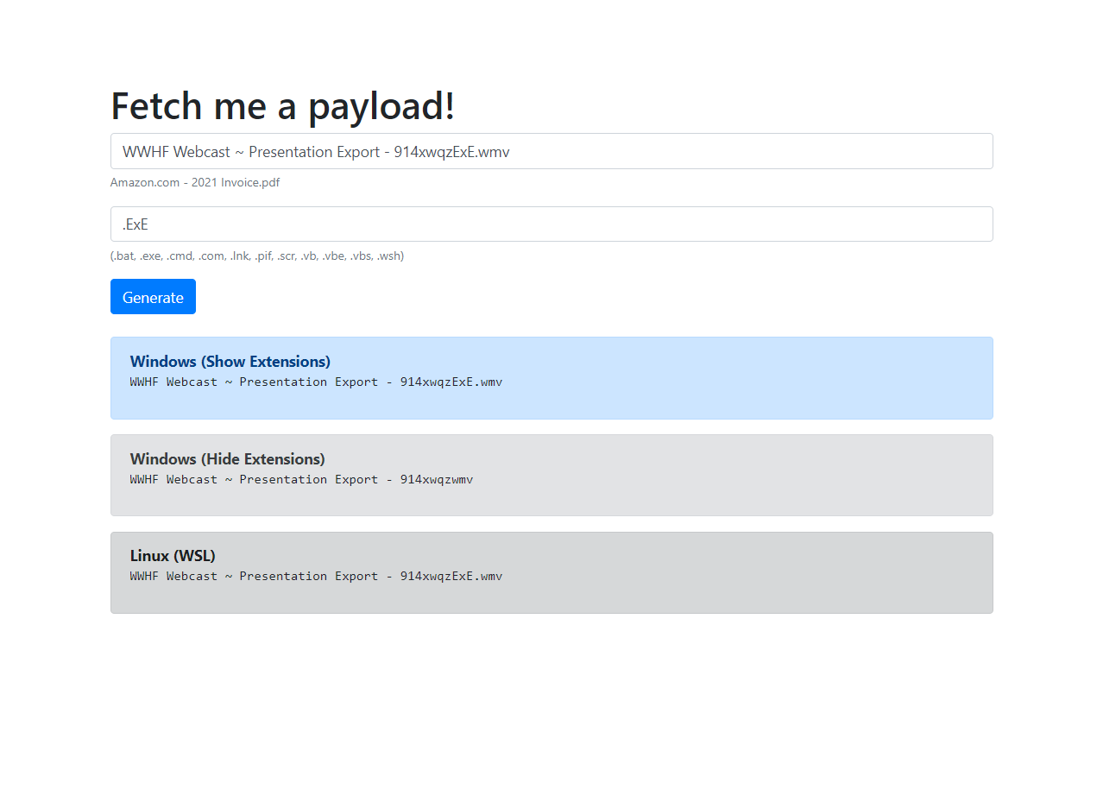
RTLO and LTRO Generator
“File Name Extensions” - Enabled

Slide 50
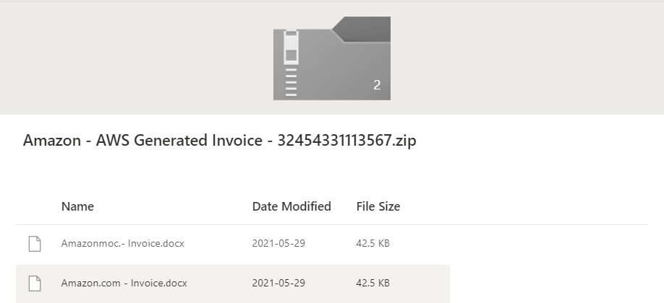
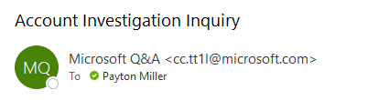
Application Abuse with Overrides

Slide 51
What can we do?

Slide 52
How to Protect Individuals
Password Managers – URL matching to prevent disclosing your credentials to domains that are illegitimate.
2FA – Individuals think twice before entering 2FA tokens and ensure that they are on valid websites.
Certain “Safe-Site” Scanners detect new domains – flagging them as malicious

Slide 53
How to Protect Individuals
Custom Chrome Themes – Prevents Windows Spoofing
If clicking a link is avoidable, consider directly navigating to the website.
Regular internal training to ensure that your organization can identify a large range of threats.

Slide 54
How to Protect your Organization
Implement valid DNS SPF / DMARC / DKIM on mail servers to prevent mail spoofing.
Reduce unnecessary domain redirections.
Consider exposing a list of domain names owned by the organization on the company’s TLD, or an exposed API to check valid endpoints.
Maintain web servers with regular vulnerability assessments, and services are secure.

Slide 55
Effective Training Techniques

Slide 56
Positive Training Techniques
Companies should pursue an open relation about phishing.
Positive Reinforcement is Powerful
Offering benefits to individuals that report and “want to learn”.

Slide 57
Issues with Phishing Training
The Scientific Method requires constants
Executives want statistics
Excluded groups are oftentimes the biggest targets (HR and Executives)
Training individuals not to click on links can result in loss of productivity.
Reports contain “Viewed Message Counts”
Adversaries will offer bonuses, promotions, etc.
Malicious actors are not limited by morals, or desire company worker satisfaction.

Slide 58
Simulations are Simply Simulations

Slide 59
ADDITIONAL RESOURCES
GitHub:
GitHub - trustedsec/social-engineer-toolkit
GitHub - kgretzky/evilginx2
GitHub - gophish/gophish
Resources:
Cross-site Scripting via WHOIS and DNS records on multiple lookup platforms - Research Advisory | Tenable®
Spoof Using Right to Left Override (RTLO) Technique - Infosec Resources (infosecinstitute.com)
Presentation Resources Github:
/naivros/Phishing-Research

Slide 60

Questions & answers
If you have any questions that have not been answered at this point, feel free to reach out to me directly on Twitter.
All scripts mentioned within this presentation are available at https://github.com/naivros/Phishing-Research
@aLilSus
@a.lil.sus#7939

